Slide 1

School of Computing
Vel Tech Rangarajan Dr. Sagunthala R&D Institute of Science and Technology
Department of Computer Science and Engineering
10211CS224 / FULL STACK APPLICATION DEVELOPMENT (JAVA)
PROJECT REVIEW : MILESTONE PROJECT – 1
Date: 24-03-2026
TRACKWISE:RELATIONAL EXPENSE ANALYTICS PLATFORM
SDG: SDG 9- Industry, Innovation and Infrastructure
Presented By:
PAVANI SWETHA – VTU26633 – 23UECS0843.
Courses Handling Faculty:
Dr.Hafizur Rahman – Assistant Professor

Slide 2
INTRODUCTION
1
Managing personal and group expenses has become complex in today’s fast-paced lifestyle. Many individuals still rely on manual tracking methods, which often lead to errors and poor financial awareness. TrackWise is designed to simplify expense tracking by providing a smart and relational analytics platform. It helps users monitor spending patterns, categorize expenses, and analyze financial relationships. The system ensures better financial planning and transparency. With the increasing use of digital payments,Tracking expenses has become more important than ever. It is useful for individuals, students, and small groups. Expense management plays a key role in achieving personal financial goals and savings. Many individuals lack awareness of where their money is being spent. A structured expense tracking system helps in improving financial transparency. Modern Users expect smart systems that not only store data but also provide analysis of spending habits. The platform also provides insights through visual analytics. Overall, it enhances financial decision-making.
2
3
4
5
6
7
8
9

Slide 3
PROBLEM STATEMENT
1
In many cases, existing expense tracking systems are not fully automated and rely on basic or manual methods. This leads to inefficiency in recording and managing financial data. Users find it difficult to analyze their spending patterns and understand relationships between different expenses.There is a lack of a simple, reliable, and intelligent platform that not only tracks
2
3
expenses but also provides meaningful insights. Users do not receive good suggestions to
4
improve financial habits. Existing systems do not offer proper visualization or relational analytics for better financial understanding. Therefore, there is a need for a smart and automated expense analytics platform that improves accuracy, enhances financial awareness, and supports better decision-making.
5
6
7
8
9

Slide 4
OBJECTIVE(S)
1
To design and develop a relational expense tracking and analytics platform.
To implement data visualization and insights for better financial decision-making.
To improve budgeting efficiency through better expense tracking and analysis.
2
3
4
5
6
7
8
9

Slide 5
PROPOSED SYSTEM
1
Provides a web-based platform for managing daily expenses
Allows users to add, edit, and delete expense records
Categorizes expenses for better organization
Stores all data securely in a structured database .
Performs relational analysis between different expense categories
Generates visual reports such as charts and graphs
Enables filtering of expenses based on date and category
Provides a personalized dashboard for each user
Ensures secure login and authentication system
2
3
4
5
6
7
8
9

Slide 6
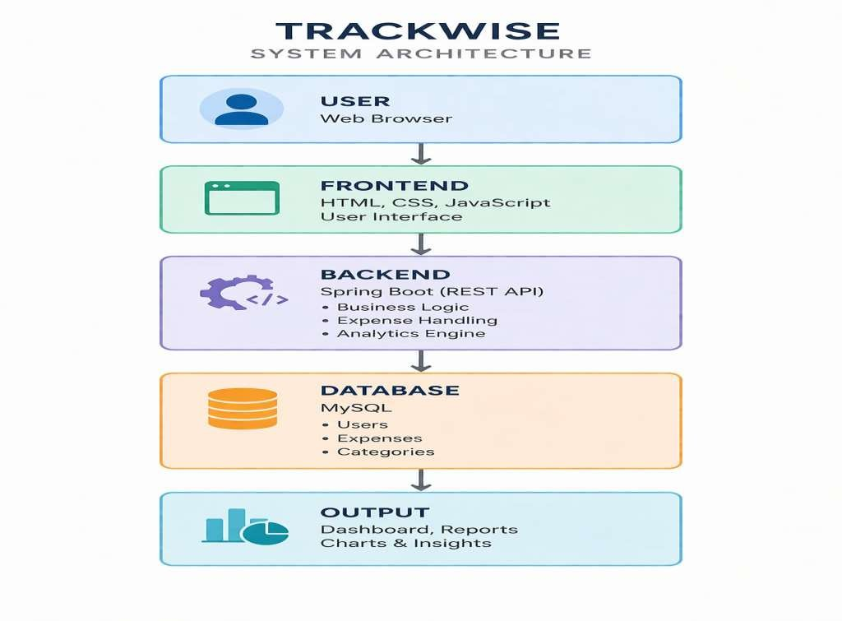
PROPOSED SYSTEM ARCHITECTURE
1
Input
User enters expense details (amount, category, date).
Processing
System processing data,categorizes expenses.
Database
Stores user data,expense records,etc.
Output
Displays reports,charts,insights to user.
2
3
4
5
6
7
8
9

Slide 7
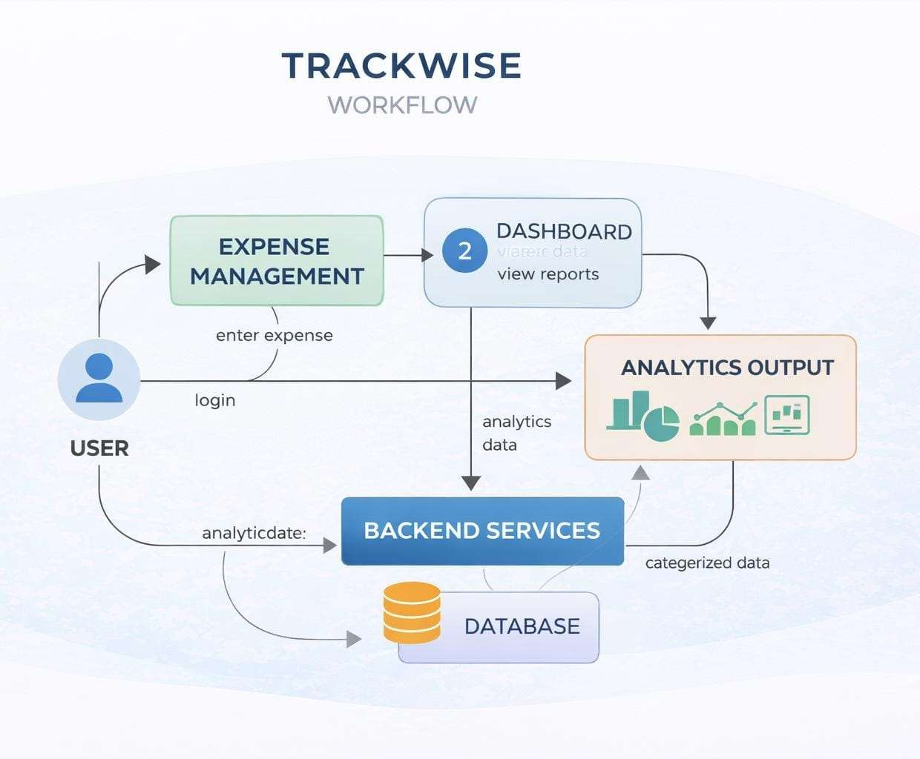
WORKFLOW
1
2
3
4
5
6
7
8
9

Slide 8
TECHNOLOGIES USED
1
Frontend: HTML,CSS,JavaScript
Backend: Java (Spring Boot)
Database: MYSQL
Tools:Note Pad ,MySQL Workbench,Github.
Hardware/Software Requirements: JDK,MYSQL Server
Web Browser
2
3
4
5
6
7
8
9

Slide 9
MODULE DESCRIPTION
1
Module 1: User Management
Handles user registration, login, and profile management with secure authentication.
Module 2: Core Processing
Allows Users to add,edit,delete,and categorize expenses.
Module 3: Database Management
Stores and retrieves user and expense data efficiently.
Module 4: Reporting & Analytics
Generates charts and insightsto analyze spending patterns.
2
3
4
5
6
7
8
9

Slide 10
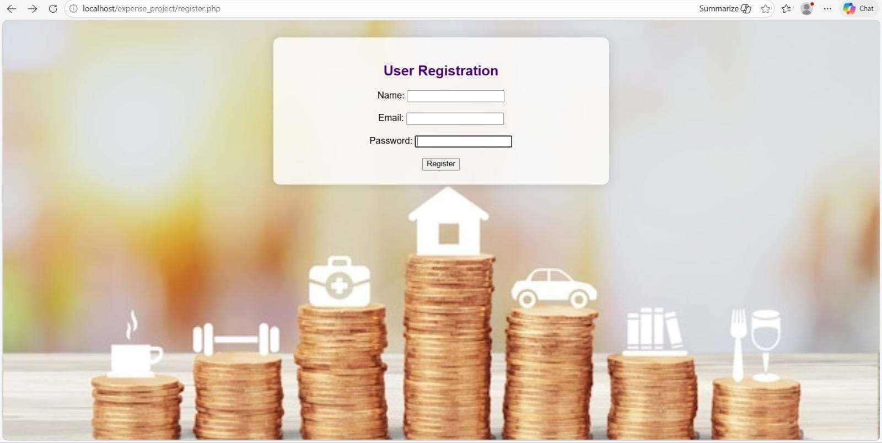
IMPLEMENTATION SCREENSHOTS
1
2
3
4
5
6
7
8
9
Home Page: This is the home page of the TrackWise system where new users can register by entering their details.It provides access to the platform for first-time users to create an account

Slide 11
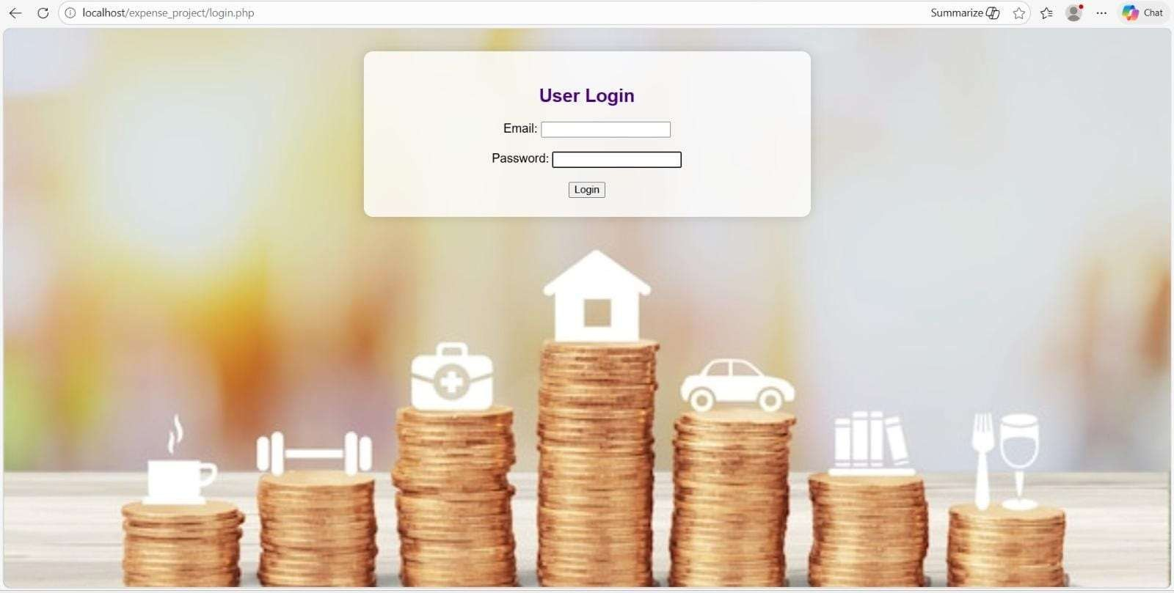
IMPLEMENTATION SCREENSHOTS
1
2
3
4
5
6
7
8(A)
Login Page : This page allows existing users to log into the system using their credentials. It ensures secure authentication before accessing the application features.
9

Slide 12
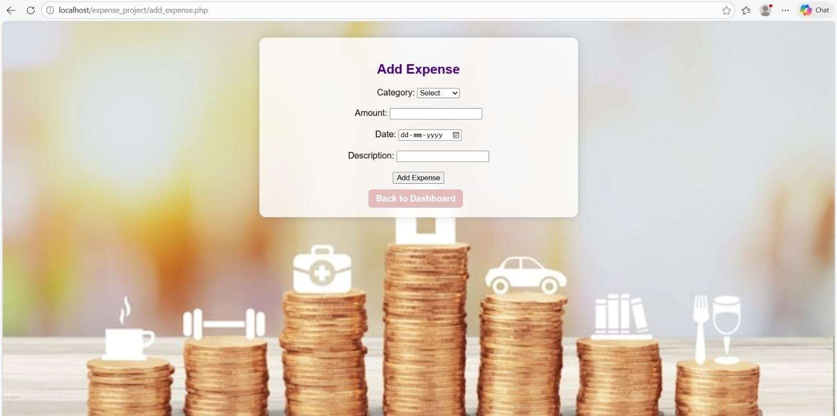
IMPLEMENTATION SCREENSHOTS
1
2
3
4
5
6
7
8(B)
Main Module: This module enables users to add daily expenses with details like amount, category, and date.It helps in organizing and managing financial data efficiently.
9

Slide 13
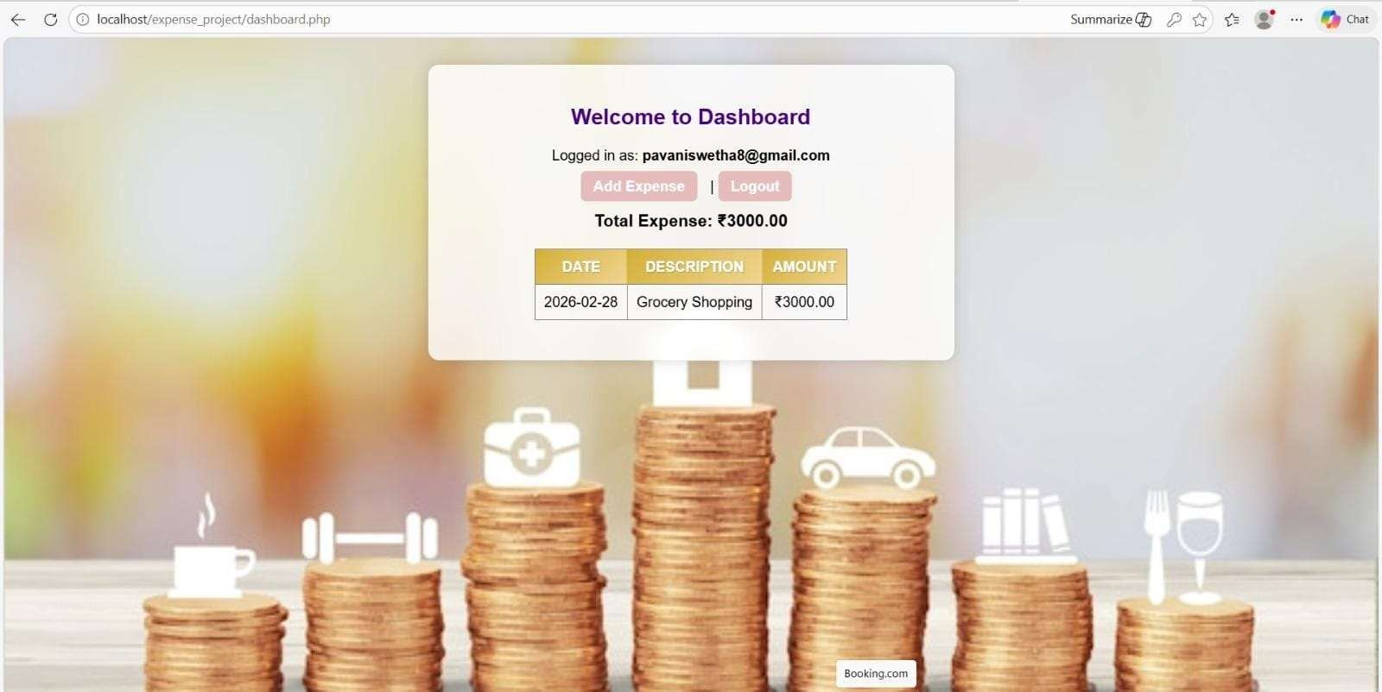
IMPLEMENTATION SCREENSHOTS
1
2
3
4
5
6
7
8(C)
9
Output Page:This page displays the recorded expenses in a structured format for easy understanding. It provides insights and helps users analyze their spending patterns.

Slide 14
ADVANTAGES & LIMITATIONS
1
ADVANTAGES:
Easy to use and user-friendly
Accurate expense tracking
Provides visual insights
Saves time compared to manual methods
2
3
4
5
LIMITATIONS:
Requires internet connection
Limited to basic analytics in current version
Data privacy depends on implementation security
6
7
8
9

Slide 15
Thank you

